Slide 1
Analog to digital conversion
Digital Signal: A digital signal is a signal that represents data as a sequence of discrete values; at any given time it can only take on one of a finite number of values.
Analog Signal: An analog signal is any continuous signal for which the time varying feature of the signal is a representation of some other time varying quantity i.e., analogous to another time varying signal.
The following techniques can be used for Analog to Digital Conversion:
a. PULSE CODE MODULATION:
The most common technique to change an analog signal to digital data is called pulse code modulation (PCM). A PCM encoder has the following three processes:
Sampling
Quantization
Encoding

Slide 2
Low pass filter : The low pass filter eliminates the high frequency components present in the input analog signal to ensure that the input signal to sampler is free from the unwanted frequency components. This is done to avoid aliasing of the message signal.
Sampling – The first step in PCM is sampling. Sampling is a process of measuring the amplitude of a continuous-time signal at discrete instants, converting the continuous signal into a discrete signal.

Slide 3
Quantization – The result of sampling is a series of pulses with amplitude values between the maximum and minimum amplitudes of the signal. The set of amplitudes can be infinite with non-integral values between two limits. The following are the steps in Quantization:
We assume that the signal has amplitudes between Vmax and Vmin
We divide it into L zones each of height d where, d= (Vmax- Vmin)/ L
The value at the top of each sample in the graph shows the actual amplitude.
The normalized pulse amplitude modulation(PAM) value is calculated using the formula amplitude/d.
After this we calculate the quantized value which the process selects from the middle of each zone.
The Quantized error is given by the difference between quantized value and normalized PAM value.
The Quantization code for each sample based on quantization levels at the left of the graph.

Slide 4
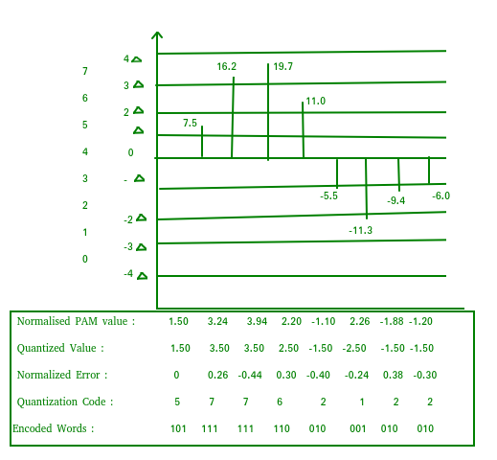

Slide 5
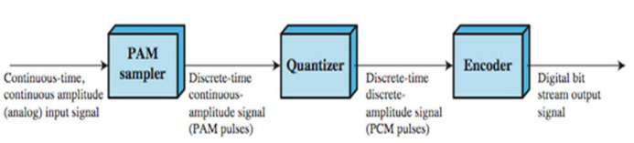
Encoding – The digitization of the analog signal is done by the encoder. After each sample is quantized and the number of bits per sample is decided, each sample can be changed to an n bit code. Encoding also minimizes the bandwidth used

